Slide 1
Predicting Lending Club Loan Defaults In Order to Reduce Default Risk for Investors
Omar Askar
December 12, 2016

Slide 2
Act I: The Challenge
In which our heroes learn that a peer-to-peer lending site is passing on risk to its investors in exchange for higher returns; is that opportunity at the door?

Slide 3
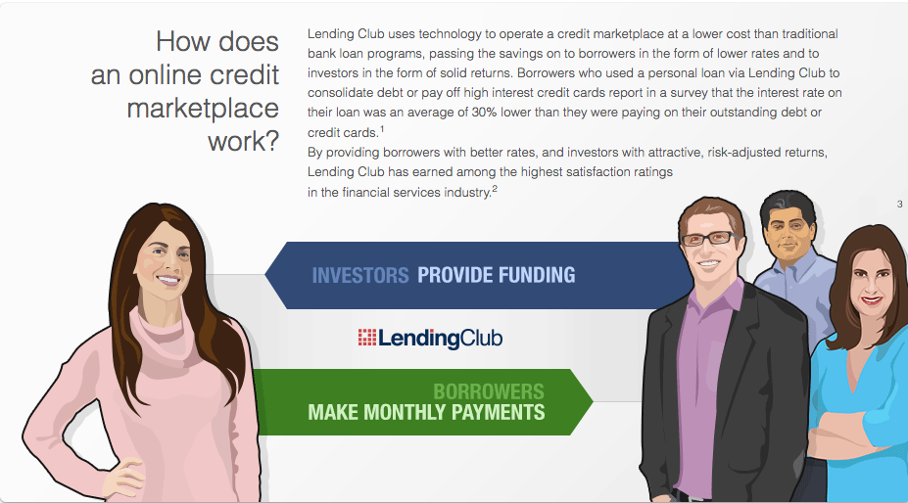
What is Lending Club?
Online loan site matching borrowers to lenders
Borrowers apply to LC; if approved, loans are listed on the LC site
LC assigns risk grade, interest rate, and monthly payment
Investors see de-personalized application details and can underwrite pieces of loans in $25 increments
Investors are encouraged to spread their money out over many loans
Borrower pays LC each month; LC keeps 1% and distributes the rest to loan investors
Source: https://www.lendingclub.com/public/how-peer-lending-works.action

Slide 4




How is it different from traditional lending?
Deposits
Bank
Loan
Original Deposit + Interest
Principal + Interest
Loan Principal
1 %
Investors are on the hook for bad loans, but can reap higher returns if they can avoid investing in them!
Principal + Interest

Slide 5
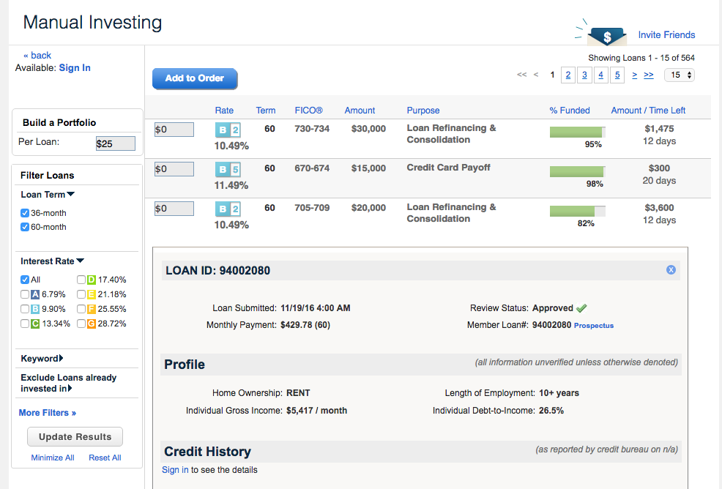
Can we help the investor avoid bad loans?
A Potential investor sees details from the borrower’s application:
Credit Score
Current Income
Employment History
Equated Monthly Installment
Repayment History
State + Partial ZIP Code
Stated Purpose
Other Personal Loan Eligibility Considerations
Goal: Use this information to recommend loans for investment
https://www.lendingclub.com/browse/browse.action

Slide 6
We set ourselves a challenge:
Can we develop a model to decrease our expected default rate by risk level for new 36-month loans, over choosing loans at random?
Bounds:
We will confine ourselves to a set of statistical techniques
We will only consider 3-year, unsecured loans
We answer the question by the end of the semester

Slide 7
SMART-ness
Criterion | Analysis
Specific | We are bounding the loans we are considering, and we have defined a single effect we are measuring
Measurable | Through simulation and cross-validation, we can measure the null and model default rate.
Answerable | We are not looking to optimize; just answering yes/no as to whether we can improve on not using a model.
Relevant | This question is relevant to investors who wish to minimize risk for a given return.
Time bound | We will limit the question to a finite list of techniques and we must finish by the time you are reading this.

Slide 8
Act II: Reconnaissance and Preparation
In which we survey where the battle will be met.

Slide 9
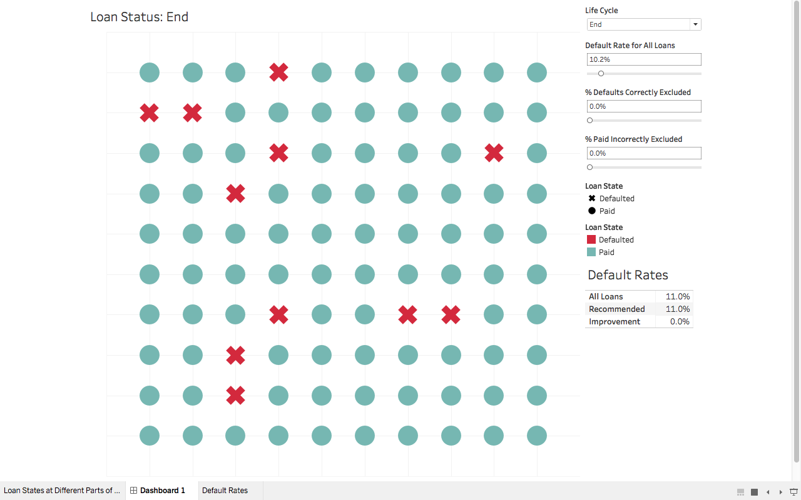
Recommendation Demonstration

Slide 10
What additional (artful) insight can we bring?
Income is not necessarily comparable from borrower to borrower due to differences in cost-of-living
Partial Zip Code
(201xx)
Annual Income
($75,000)
Loan Amount
($5,000)
Geonames
Probable County
(Loudoun, VA)
HUD 50% Rent
Median 2 BR Rent
($1300)
Adjusted Income
($59,400)
Loan as % Adj Inc
(8.4%)

Slide 11
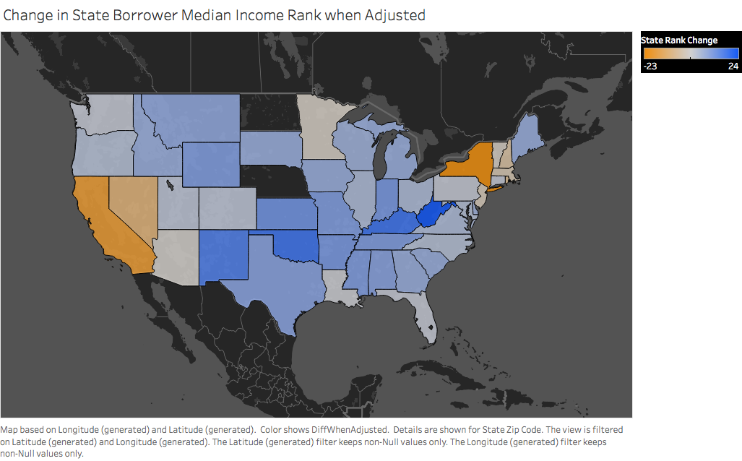

Slide 12
Background – Dataset
36-month LC loans that originated between Jan. 2012 and Sep. 2013
Approved loans data are 111,808 loans with 111 variables for each
Data used is the information provided by LC to investors when offering the loan for funding
Many variables are included (e.g. amount of loan, stated purpose of loan, credit worthiness of borrower, employment status and length, debt load, etc.)

Slide 13
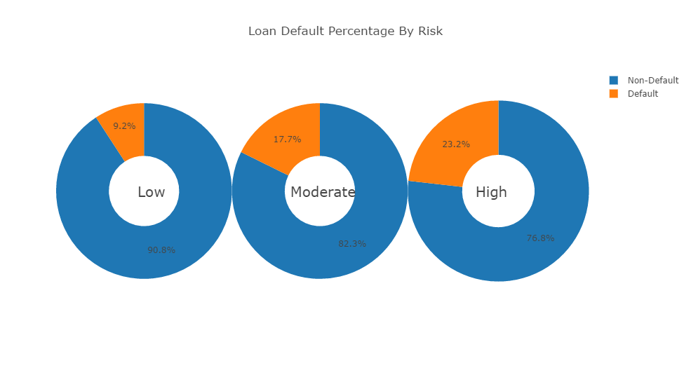
What are the default rates?

Slide 14
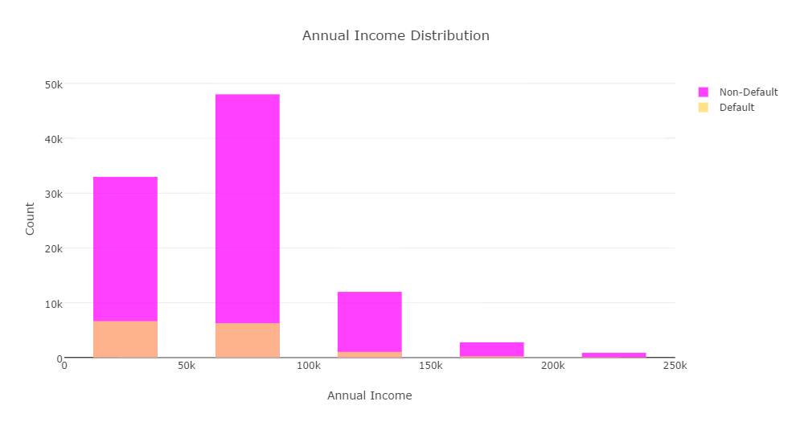
How much do borrowers earn annually?

Slide 15
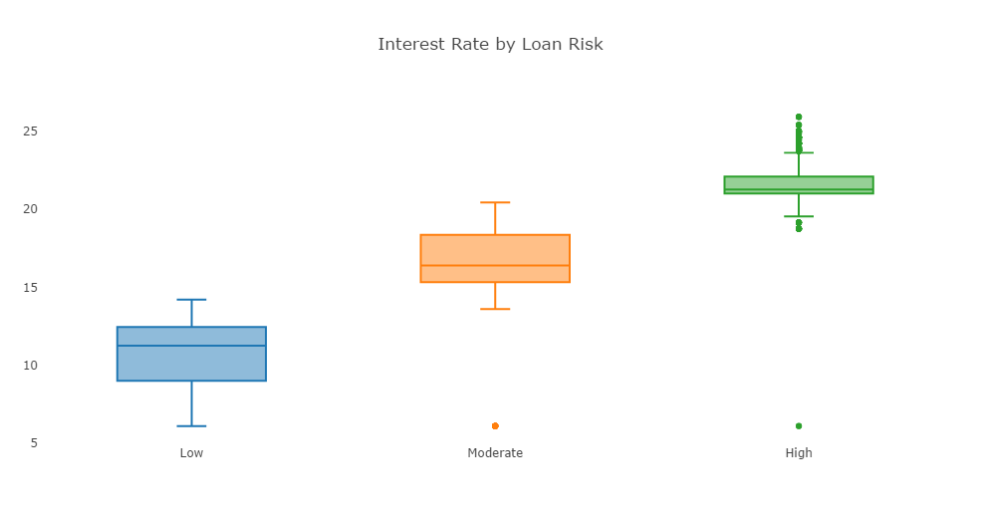
What is the interest rate by Loan Risk?

Slide 16
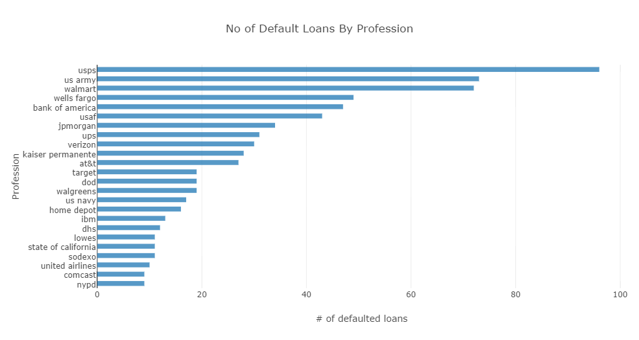
What is the number of defaulted loans by profession?

Slide 17
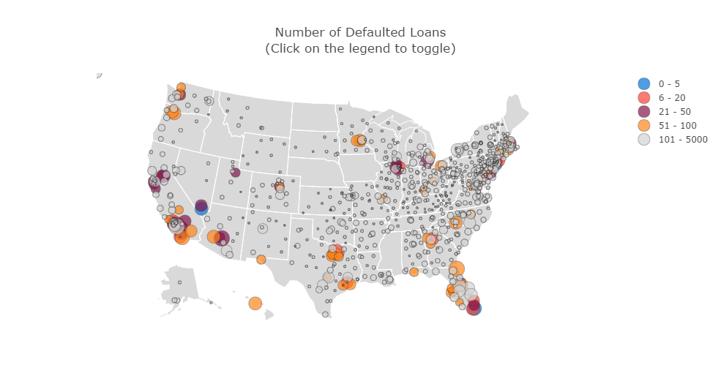
What is the distribution of default loans across the US?

Slide 18
Act III: Engagement
In which the heroes attempt to unlock the secrets of the data.

Slide 19
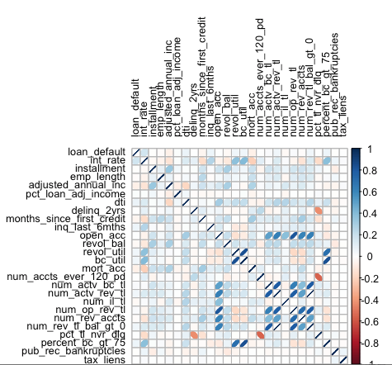
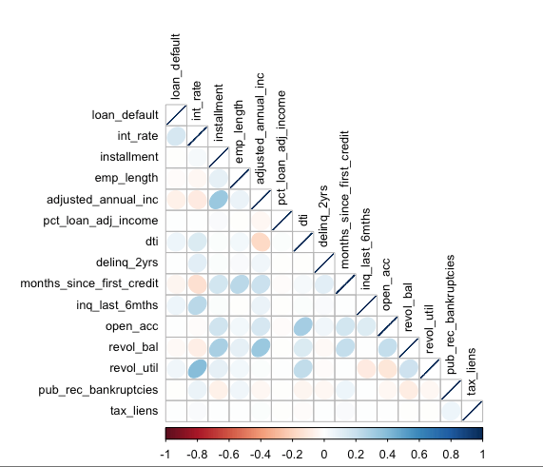
Models and Analysis – Variables
Started with 100 + variables
Variables of location, employment titles, ids, dates, and others that would not be available at time of loan origination were removed for irrelevance
Variables used to create adjusted income were also removed (linear combinations of the original income variables)
Plot correlations suggests the removal of an additional 10 variables
This left 17 candidate independent variables of which 14 were selected for predictive modeling

Slide 20
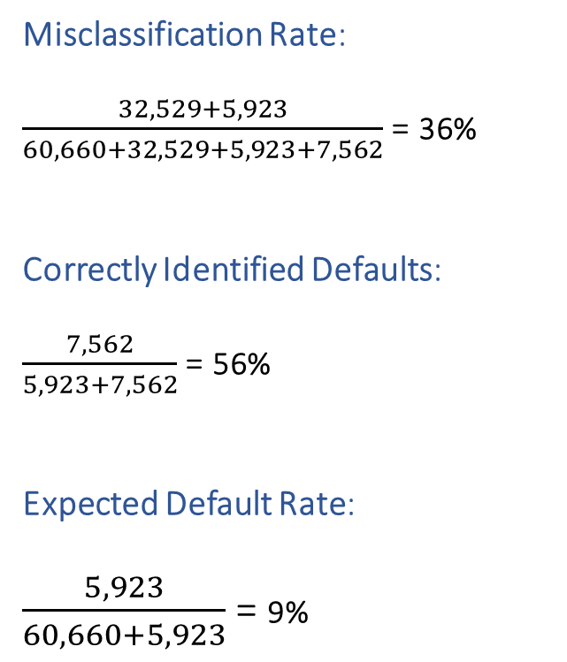
Explanation of Key Measures of Model Output
Misclassification Rate:
$\frac{32,529+5,923}{60,660+32,529+5,923+7,562}$ = 36%
Correctly Identified Defaults:
$\frac{7,562}{5,923+7,562}$ = 56%
Expected Default Rate:
$\frac{5,923}{60,660+5,923}$ = 9%
Predicted Outcome From Model
Good Loan (Non-default) Bad Loan (Default)
60,660 | 32,529
5,923 | 7,562
The Truth
Bad Loan Good Loan
(Default) (Non-default)

Slide 21
Models and Analysis Null Model
Expected error rates and correctly identified defaults (%) when all loans are predicted to not default
The Null model was used as a baseline comparison for model performance of logistic regression and linear discriminant analysis
Lending Club Assigned Risk | Total Loans | Resulted in Default | Misclassification Rate (%) | Correctly Identified Defaults (%) | Expected Default Rate (%)
All Loans | 106,698 | 13,488 | 13% | 0% | 13%
Low | 62,798 | 5,650 | 9% | 0% | 9%
Moderate | 40,720 | 7,114 | 17% | 0% | 17%
High | 3,180 | 724 | 23% | 0% | 23%

Slide 22
Models and Analysis Logistic Regression
Model Selection
Logistic regression allows for incorporation of factor variables (loan risk, home ownership status)
14 independent variables selected by mixed stepwise logistic regression (AIC)
AIC = 2(number of parameters) – Model Deviance
Penalizes models with lots of parameters or poor fit
Goodness of Fit
Cross Validation (2-fold) with 60% training data and 40% testing data
Validation was repeated 1,000 times
The average rates are displayed in the table below
Lending Club Assigned Risk | Misclassification Rate (%) | Correctly Identified Defaults (%) | Expected Default Rate (%) | Error Rate Improvement over Null (Percentage Points)
All Loans | 19.7% | 25.2% | 10.9% | 2%
Low | 9.1% | 0.3% | 9.0% | 0%
Moderate | 33.0% | 39.4% | 15.0% | 2%
High | 58.0% | 79.7% | 16.2% | 7%
Notes:
Misidentified bad loans?? (in David’s slides)

Slide 23
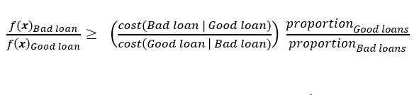
Models and Analysis Linear Discriminant Analysis
Model Selection
LDA allows for incorporation of cost ratios within each loan risk category
For our model the cost ratios by loan risk level were:
Low risk : 1/60
Moderate risk : 1/30
High risk :1/15
Goodness of Fit
Cross Validation – Leave One Out (LOOCV)
Validation was repeated 100,000+ times
The average rates are displayed in the table below
Lending Club Assigned Risk | Misclassification Rate (%) | Correctly Identified Defaults (%) | Expected Default Rate (%) | Error Rate Improvement over Null (Percentage Points)
All Loans | 36.0% | 56.1% | 8.9% | 4%
Low | 13.0% | 10.1% | 8.6% | 0.4 %
Moderate | 69.0% | 89.1% | 11.0% | 6%
High | 68.4% | 90.9% | 15.9% | 7%

Slide 24
Act IV: Dénouement

Slide 25
Conclusion
Can we develop a model to decrease our expected default rate by risk level for new 36-month loans, over choosing loans at random?
Yes!
This is a piece of a larger analysis that could be done:
Using the recommendations, what strategy produces the highest returns?
How does taking into account when default happens versus the loan life affect the analysis?

Slide 26
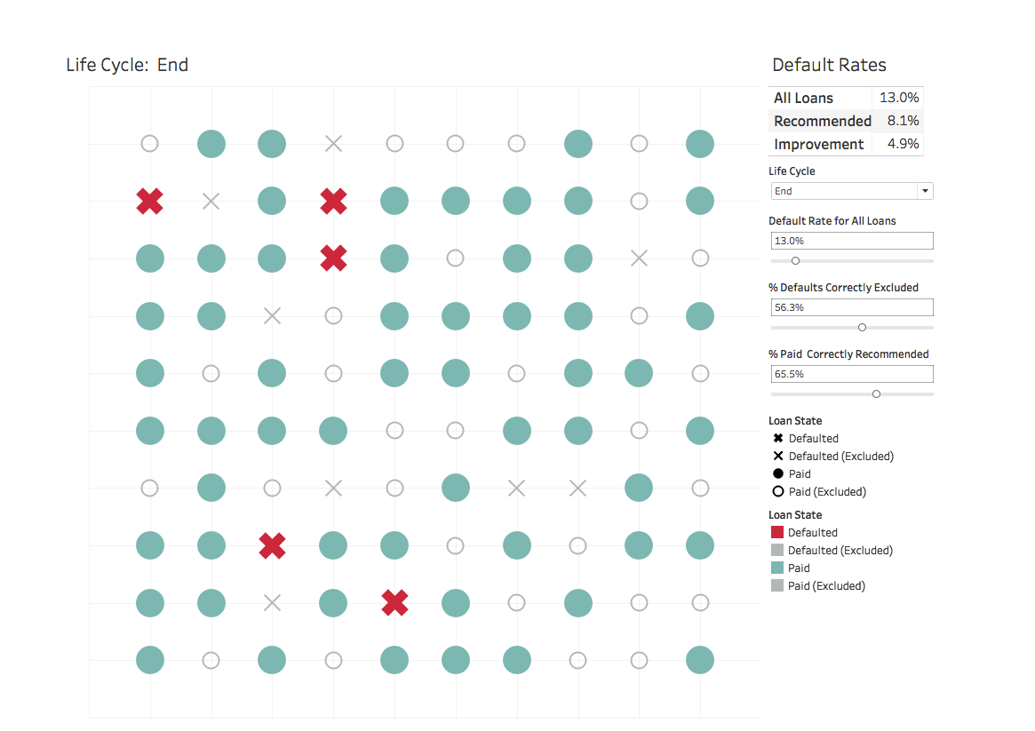

Slide 27
Ripley, B. D. (n.d.). R: Choose a model by AIC in a Stepwise Algorithm. Retrieved December 11, 2016, from https://stat.ethz.ch/R-manual/Rdevel/ library/stats/html/step.html Johnson, R. A., & Wichern, D. W. (1982). Applied Multivariate Statistical Analysis. Englewood Cliffs, NJ: Prentice-Hall. Schneider, J. (n.d.). Cross Validation. Retrieved December 11, 2016, from https://www.cs.cmu.edu/~schneide/tut5/node42.html PennState College's course of Applied Multivariate Statistical Analysis. Retrieved December 11, 2016, from https://onlinecourses.science.psu.edu/stat505/node/89 Duke University's Regression Models information page. Retrieved December 11, 2016, from https://people.duke.edu/~rnau/regstep.htm GeoNames. (n.d.). Retrieved November 20, 2016, from GeoNames: http://download.geonames.org/export/zip/US.zip U.S. Department of Housing and Urban Development. (n.d.). Retrieved November 20, 2016, from Office of Policy Development and Research (PD&R): https://www.huduser.gov/portal/datasets/50thper/FY2012_FMRS_50_County.xls Data set retrieved from the Lending Club Coorporation online platform: https://www.lendingclub.com/info/download-data.action
Bibliography

